Slide 1
A Public Health Approach To Addressing Suicides
Ray Daw
Administrator
Behavioral Health
2017

Slide 2
Learning Objectives
1. Summarize the public health model as a framework to improve impacts on suicides
2. Review trends in suicide attempts, death trends, and demographics for effective evaluation
3. Identify ways to apply the public health pyramid to plan a suicide service delivery system

Slide 3
Adverse Impressions
- Everyone is killing themselves
-Young people are committing suicide
-All communities have suicide deaths
-BH has isolated from people other groups
BH has no cultural services

Slide 4
Learning Objective 1
Summarize the public health model as a framework to improve impacts on suicides

Slide 5
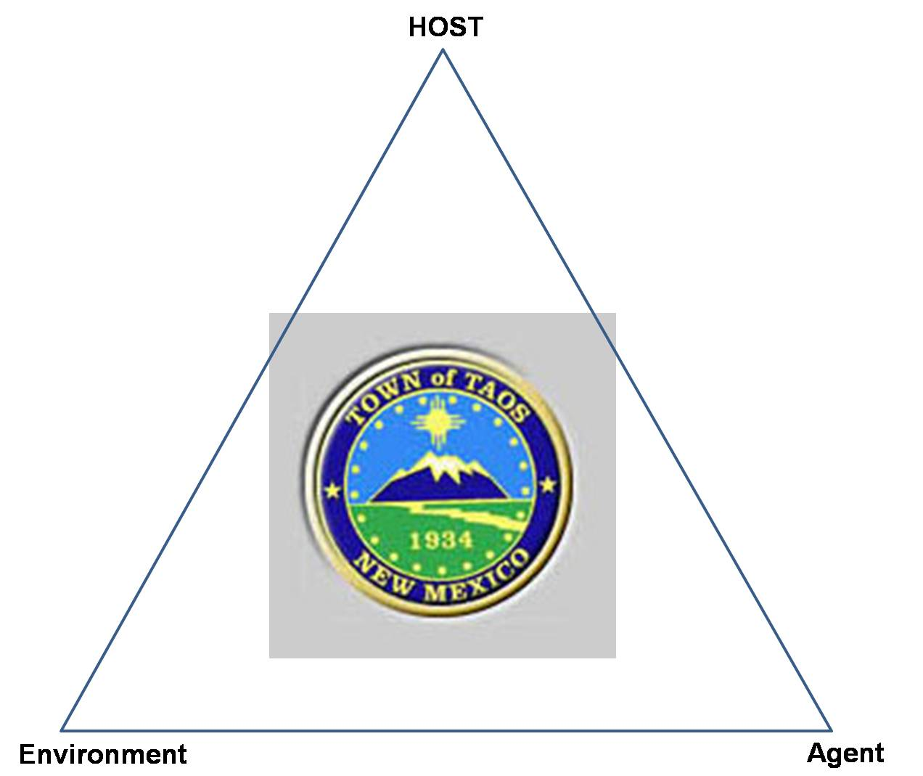

Public Health model
PUBLIC
HEALTH

Slide 6
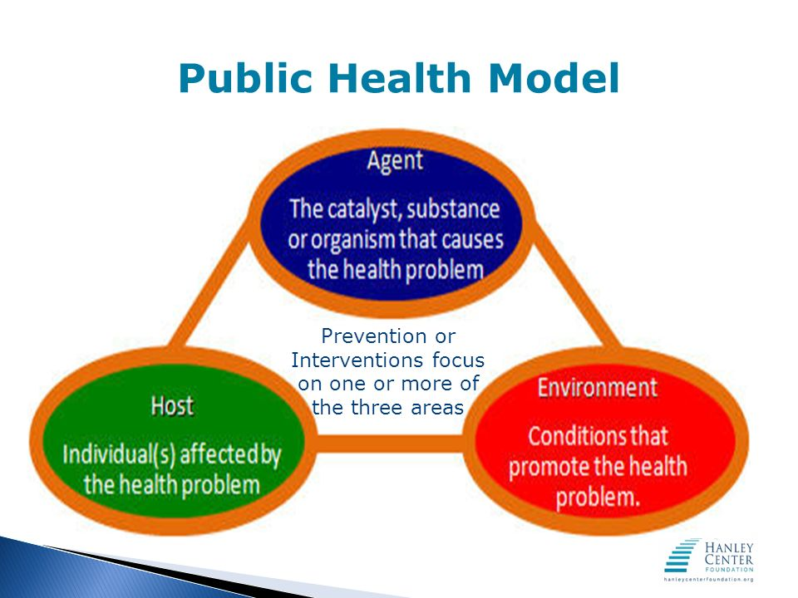

Slide 7
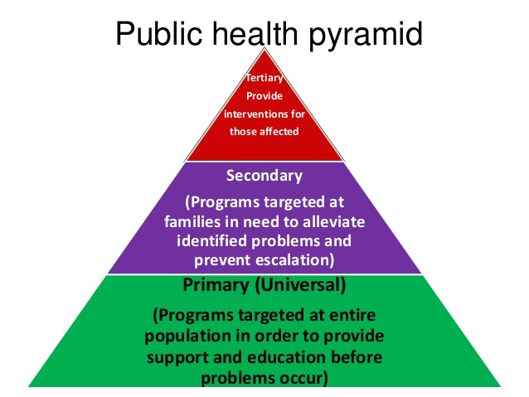

Slide 8
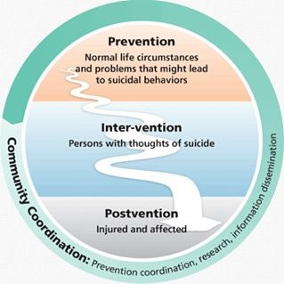
8
Notes:
8
Teaching postvention prior to a death
Utilizing postvention protocols after a death

Slide 9
Six Strategies to Address Suicide
1. Partnership: systematic planning in the development of suicide prevention programs and ongoing evaluation.
2. Prevention/Education: a coordinated approach that emphasizes the organization of resources and culturally appropriate services.
3. Treatment Services: Promoting and supporting the presence of protective factors by including Traditional and Faith-based practices
4. Training: Gatekeeper training for others to work collaboratively.
5. Staff Recruitment: Workforce shortages limit the scope of behavioral health services.
6. Data/Survelliance: data to establish priorities and program evaluation of prevention strategies
Anselm Roanhorse, MPH

Slide 10
Cluster and Contagion (CDC)
A suicide cluster may be defined as a group of suicides or suicide attempts, or both, that occur closer together in time and space than would normally be expected in a given community. The response should be conducted in a manner that avoids glorification of the suicide victims and minimizes sensationalism.
Suicide "contagion," a process by which exposure to the suicide or suicidal behavior of one or more persons influences others to commit or attempt suicide (5). Evidence suggests that the effect of contagion is not confined to suicides occurring in discrete geographic areas. In particular, nonfictional newspaper and television coverage of suicide has been associated with a statistically significant excess of suicides

Slide 11
Learning Objective 2
Review trends in suicide attempts, death trends, and demographics for effective evaluation

Slide 12
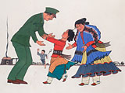

Slide 13
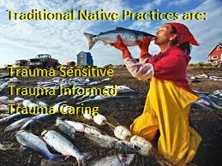

Slide 14
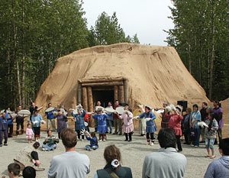
The Native American experience
Qasiq
Colonization and forced migration of tribes
Internment of tribes after conquest
Repression of indigenous practices, beliefs, language, and identity
Paternalism by governmental institutions, religious organizations, & reorganization of established governance systems.

Slide 15
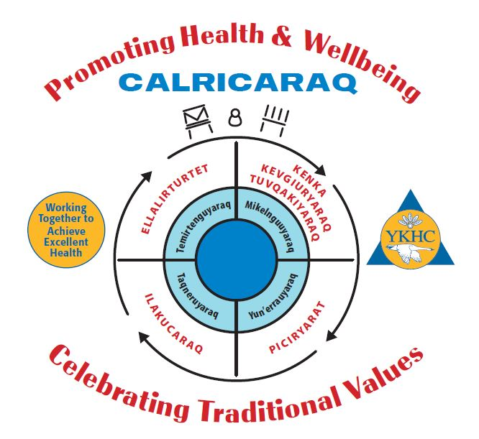

Slide 16
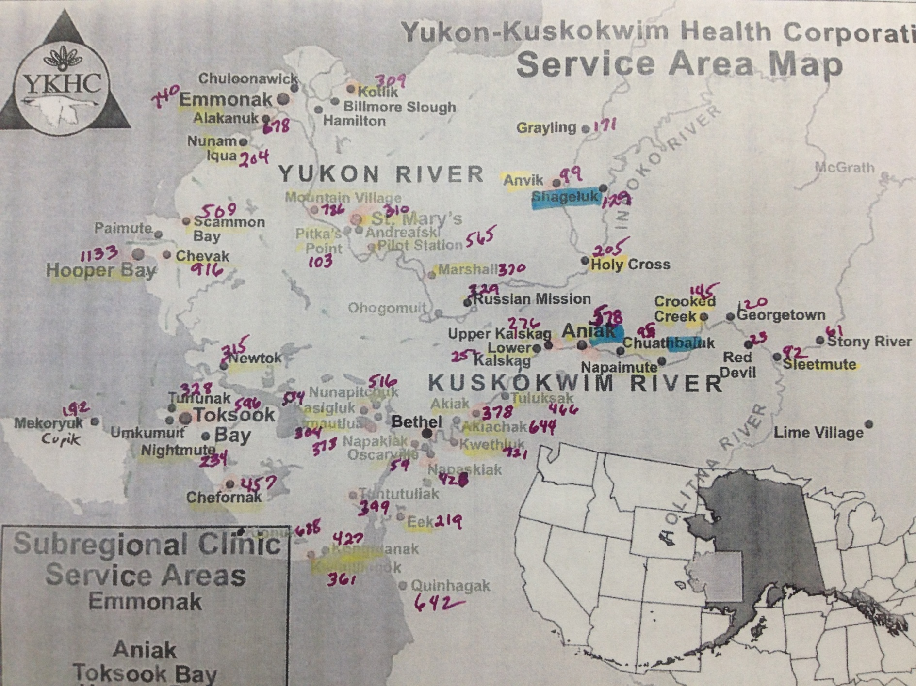
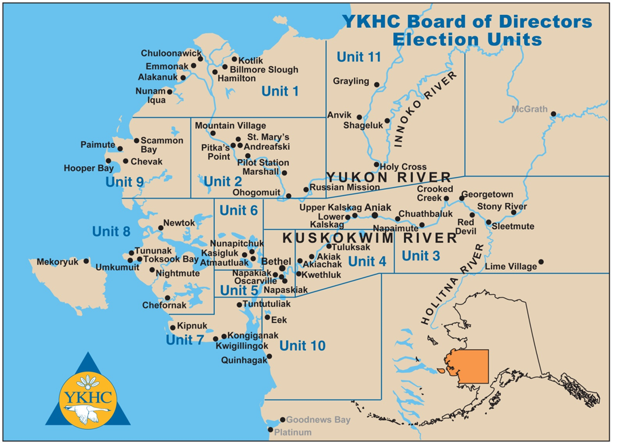
-58 tribes
-size of Oregon
-poorest region in the state of Alaska
-No road system
-air & boat travel

Slide 17
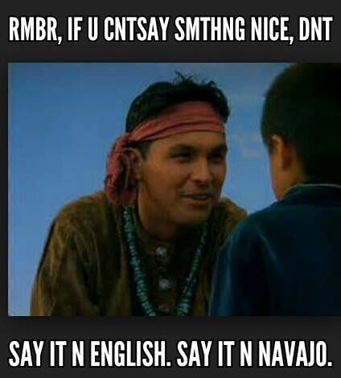

Slide 18
Learning Objective 3
Identify ways to apply the public health pyramid to plan a suicide service delivery system

Slide 19
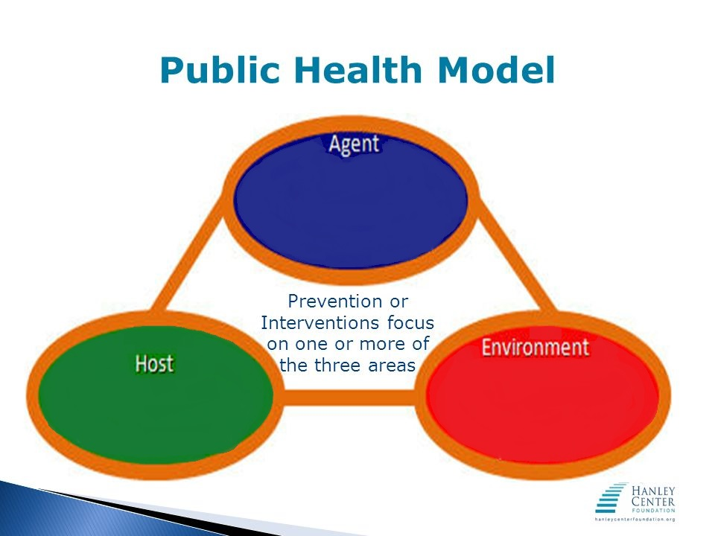
Deaths
Guns and hanging
90% Intoxicated
Social Isolation
Historical trauma
Acculturation
Assimilation
Ages 18-28
90% Male

Slide 20
Attempts
&
Ideation
Pills
37.89% Intoxicated
Social Isolation
Historical trauma
Acculturation
Assimilation
Ages 11-28
47.25% Male

Slide 21
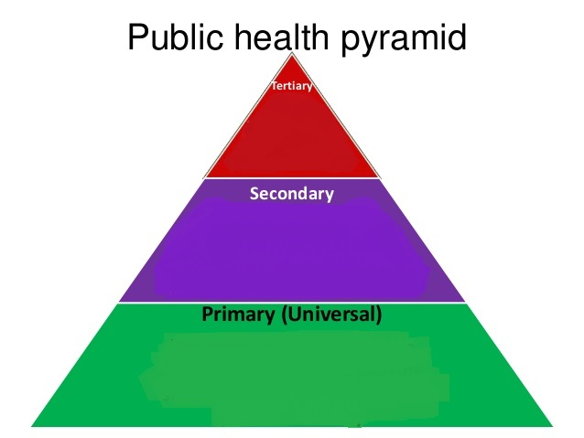
24/7 ES
Sobering Center
Crisis Response
Traditional Counseling
PCQ-9
Village Gatherings
Qaruyun (Yupik healing)
Calricaraq (
Public Info; vitamin D, suicide info, Opioids
Radio talks

Slide 22
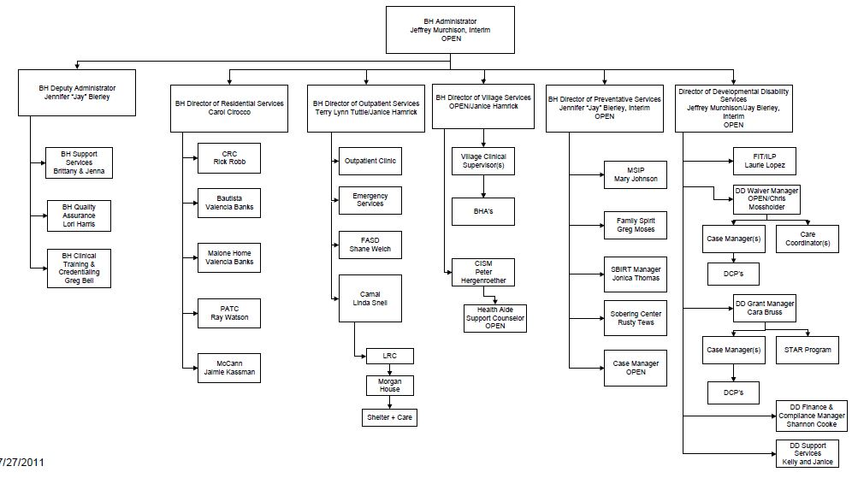
2011 BH Org Chart

Slide 23
2017 BH Org Chart

Slide 24
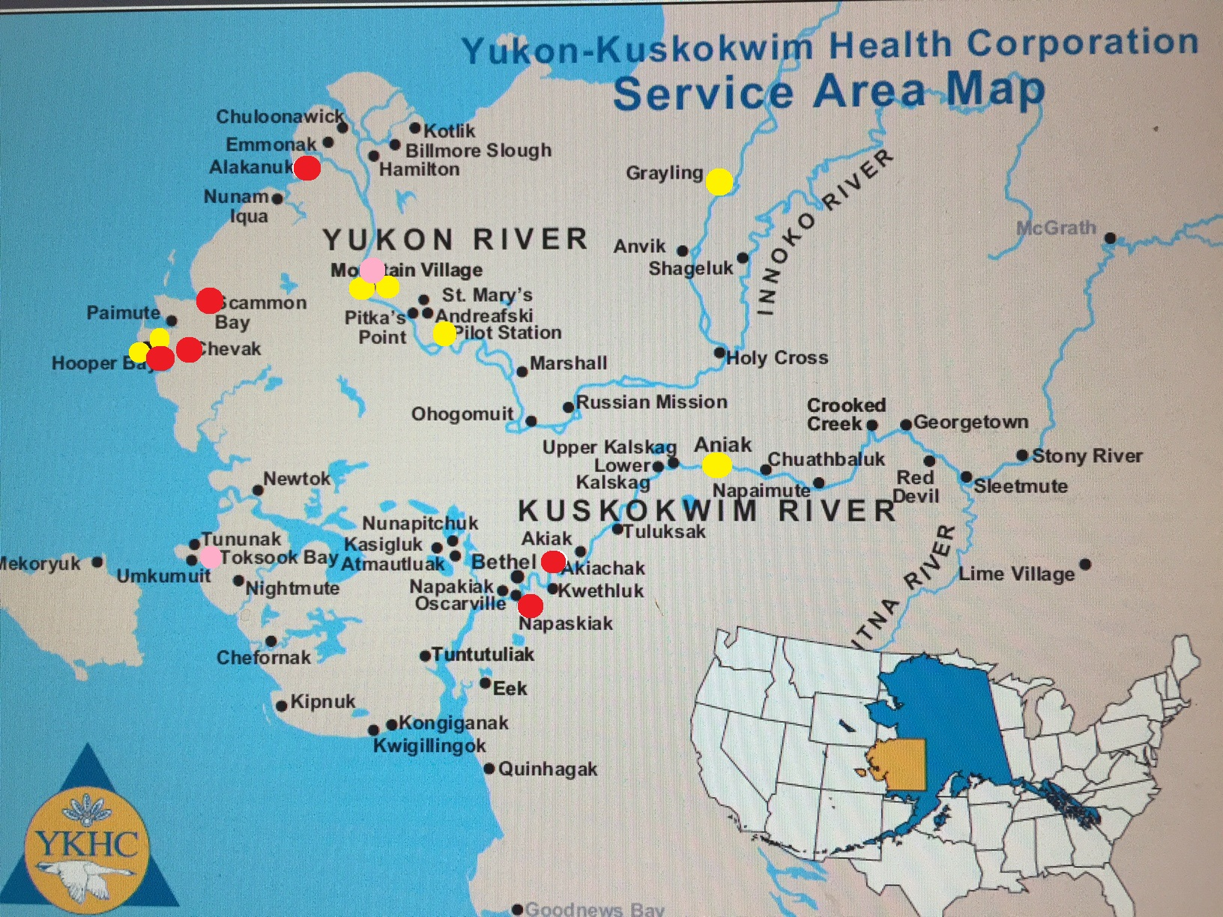
2015 Vitamin D Levels

Slide 25
Innovations: A Community Approach
PC CARES: Promoting Community Conversations About Research To End Suicide (www.pc-cares.org)
PC CARES shares bite sized research findings w/community groups
Invites community to discuss relevancy, usefulness, next steps
Assumes local knowledge is key
Creates a learning and dialogue space each month to discuss research findings
Foster community collaborations, analysis, insight
Scientific research can strengthen and guide community action

Slide 26
Workforce Development
2015 Suicides
YKHC and KUC/UAF partnership
Advisory Committee membership
RHS certificate 34-college credits/College Certificate
HUMS AAS degree 63-college credits/AAS degree
BSW degree 120-college credits/degree

Slide 27
Rural Health Services (RHS)
RHS College Certificate: ANTHC BHA I and II, CDC I, AK State BH competencies, ASIST suicide intervention, Mental Health First Aid, NICWA Positive Indian Parenting (PIP), Green Dot Prevention
YKHC-BH co-instructors
34 college credits w/ 27 applying to the HUMS AAS

Slide 28
Human Services (HUMS);
RHS graduates move into HUMS
Associate Degree with Elder co-instructors
ANTHC BHA II or III, CDC II
YKHC-BH co-instructors
All HUMS courses also apply to the BSW

Slide 29
YK Health Corporation
*13 BH employees in the RHS program, 35 + graduates
*4 employees in the HUMS AAS program, 18 graduates
*5 employees in the BSW program
*2 employees in the MSW

Slide 30
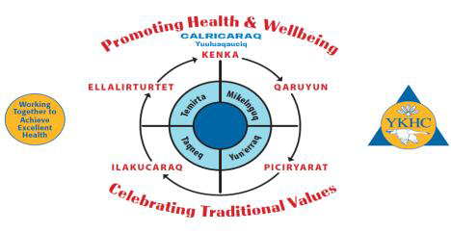

Slide 31
Q u y a n a A’hee’hee’

